Slide 1


Status Update
The DarkLight Experiment
Jesmin Nazeer
Hampton University
Nuclear Physics Group Meeting 11/08/2016

Slide 2
Motivation
It is a possibility that Dark Matter could have its own sector of forces.
There are some anomalies that Standard Model cannot explain such as Muon g-2 derivation from the SM.
A heavy boson - A’ – could explain these anomalies.

Slide 3
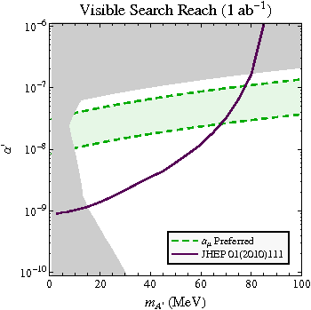
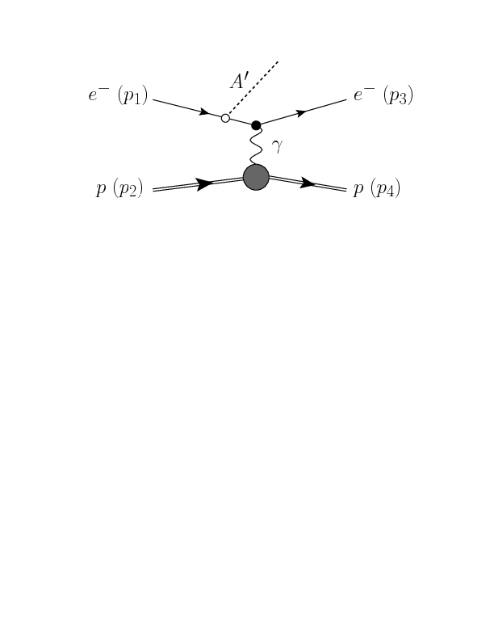
DarkLight Experiment Overview
Search for a dark photon A’ in the mass range of 10-100 MeV/c² which is possibly coupled to leptons.
Reconstruct tracks of all four final Particles.
Invariant mass of the e+/e- pair gives
the mass of A’

Slide 4
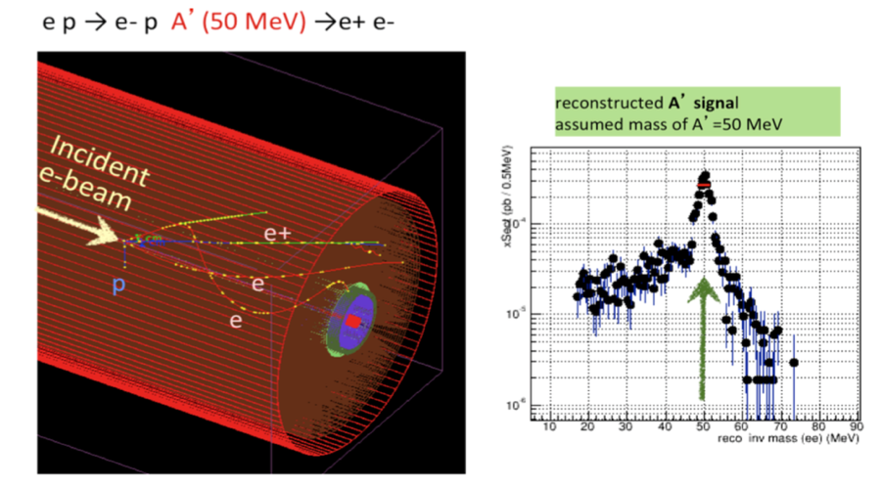
Tracking and Reconstruction

Slide 5
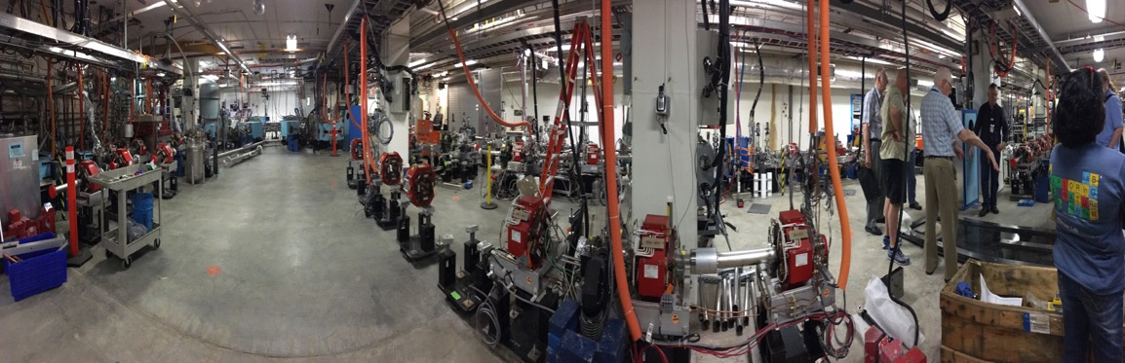
LERF at Jefferson Lab
5mA electron beam with 100 MeV energy is delivered to a windowless Hydrogen target in 0.5T solenoidal field.

Slide 6
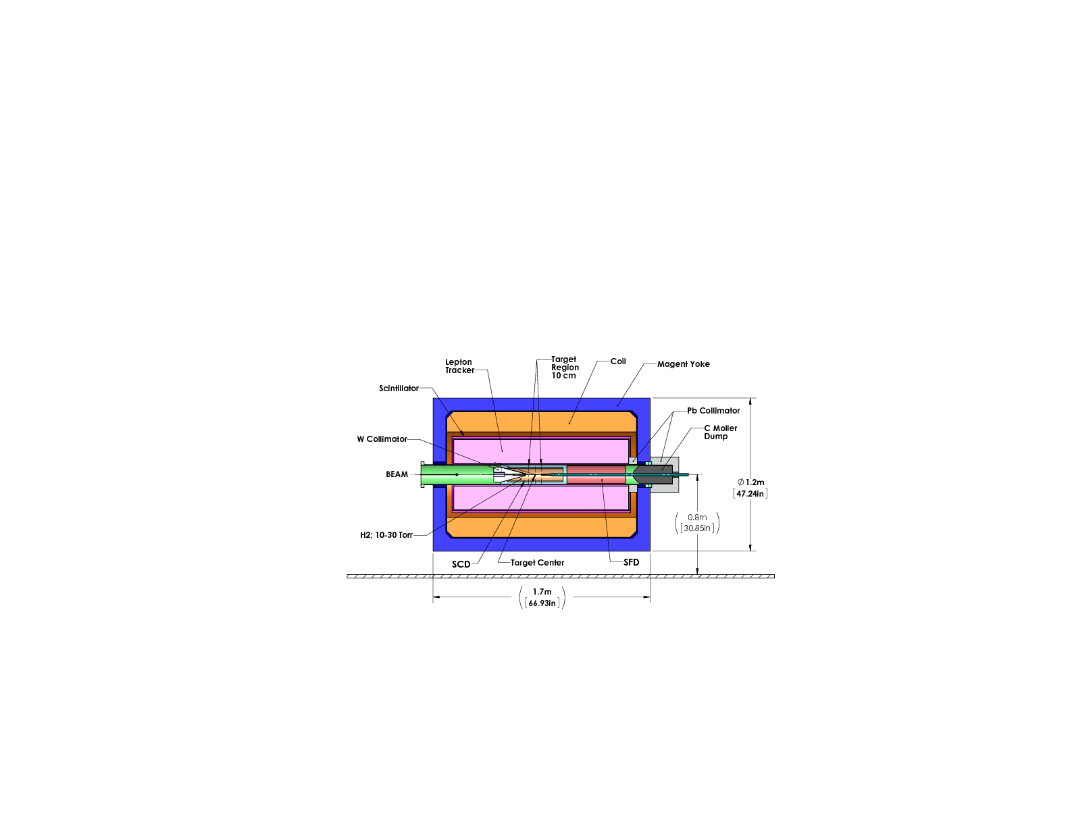
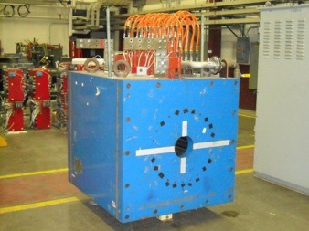
Design Overview
6 coil Toroidal Magnet
field-free region along beam-target interaction region
Target chamber
10⁻¹⁹ H-atoms/cm⁻² – Radius=2 mm, Length=30cm, Flow rate=1.5x10¹⁸ s⁻¹ , Target P= 100 torr
Proton Detector
A radial TPC – made of Kapton - detect low energy recoil protons down to 1MeV
Lepton Tracker - GEM detector
Trigger scintillators
Trigger the scattered electrons

Slide 7
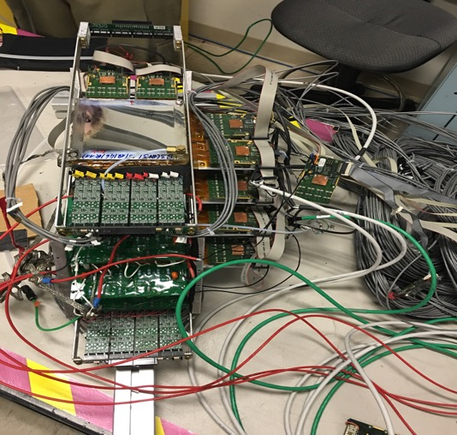
GEM Detectors
GEM telescope Specifications-
Consists of four 10x10 triple layer GEM chambers
Each GEM has four APV-25 frontend chips connected to x and y axis.
2000 readout channels total.
GEMs were supplied ArCO₂ gas mixture in 75:25 ratio

Slide 8
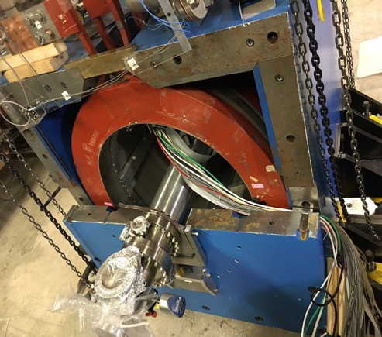
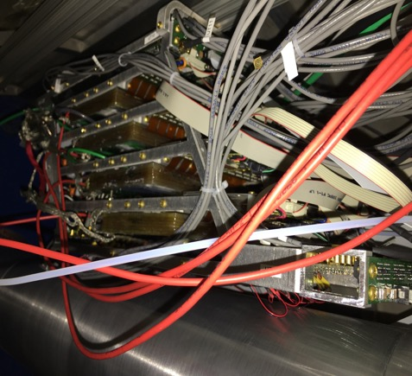
GEM Detectors
The GEM stack was installed inside the solenoid above the beam pipe.

Slide 9
Aug/Sep Run 2016
Was an engineering run.
Successfully acquired few hours of data.
Data taking-
  Took multiple latency scans to time in GEMs
  Recorded large 'splash' samples without target gas.
  Recorded 1k events with target at 300 mTorr

Slide 10
Problems and Issues
Alignment:
-Beam was never able to pass clearly through the target region.
-Need to align to axis of magnet with precision of less than a millimeter.
-Should have a test run where the laser is mounted and clearly through moller dump, i.e. sight down through target weeks in advance.
Pumping
-Pumping was less effective than predicted.
-Turbo 1 broke, hypothesis is that this was due to shaking during valve closure.
-Also, pumps were not vertically aligned well.

Slide 11
Problems and Issues
GEMs
-Problems with I2C communication (i.e. couldn't program APVs)
-APVs intermittently became non-responsive with no clear way to recover (4 APVs absent during data taking)
Trigger Paddles
-One v812 malfunctioned after installation.
-Slow controls incident damaged more channels, not clear what happened.
Slow Controls
-Slow controls webserver occasionally froze
-Various bugs
11/8/16
10

Slide 12
Data Analysis
The DAQ system is almost different than what we used before for the MUSE experiment.
So the DAQ code has been adjusted by Anusha to read new data type.
Still the Data Analysis is in the beginner’s phase.

Slide 13
Raw ADC spectra – x axis

Slide 14
Raw ADC Spectra – y axis

Slide 15
1D Raw ADC spectra

Slide 16
Continue..
Mapping has to be corrected accordingly, since we changed some of the APV cards from v3.1 to v3.0 at LERF.
More analysis has to be done to see clean clusters..

Slide 17
Goals for coming weeks
cC
Data Analysis:
-Adjust mapping
-Pedestal subtraction from the raw ADC spectra for each strip
-Common mode noise correction for each event
Hardware
-Replace broken APVs in the DL GEM stack.

Slide 18
THANK YOU!

